Slide 1
Problem Discovery MicroSprint
Tuesday, December 7, 2021

Slide 2
Welcome | Facilitator

Slide 3
Welcome | Before Getting Started
Session may be recorded. Audio recordings for internal use only.
Please provide name and email for follow up questions or clarifications.

Slide 4
Welcome | Goals
Today
Identify 3 high-impact clinical problems
Long Term
Develop a medical device solution to address identified problem
or
Develop a set of new practices focused on quality improvement
Notes:
solution that addresses one of those problems.

Slide 5
Welcome | MicroSprint Steps
Welcome
Warm-up
Reflection
Ideation
Blocklist
Individual Voting
Problem Pitch
Final Vote
Wrap-up
Overview, rules and housekeeping
Creative exercise to shift mindset
Quiet period to consider facilitator prompts
Brainstorming problems
Quick filter for out-of-scope problems
Pick your personal best
Tell us
Group voting for ‘best’ problem
Final words and next steps
Notes:
solution that addresses one of those problems.

Slide 6
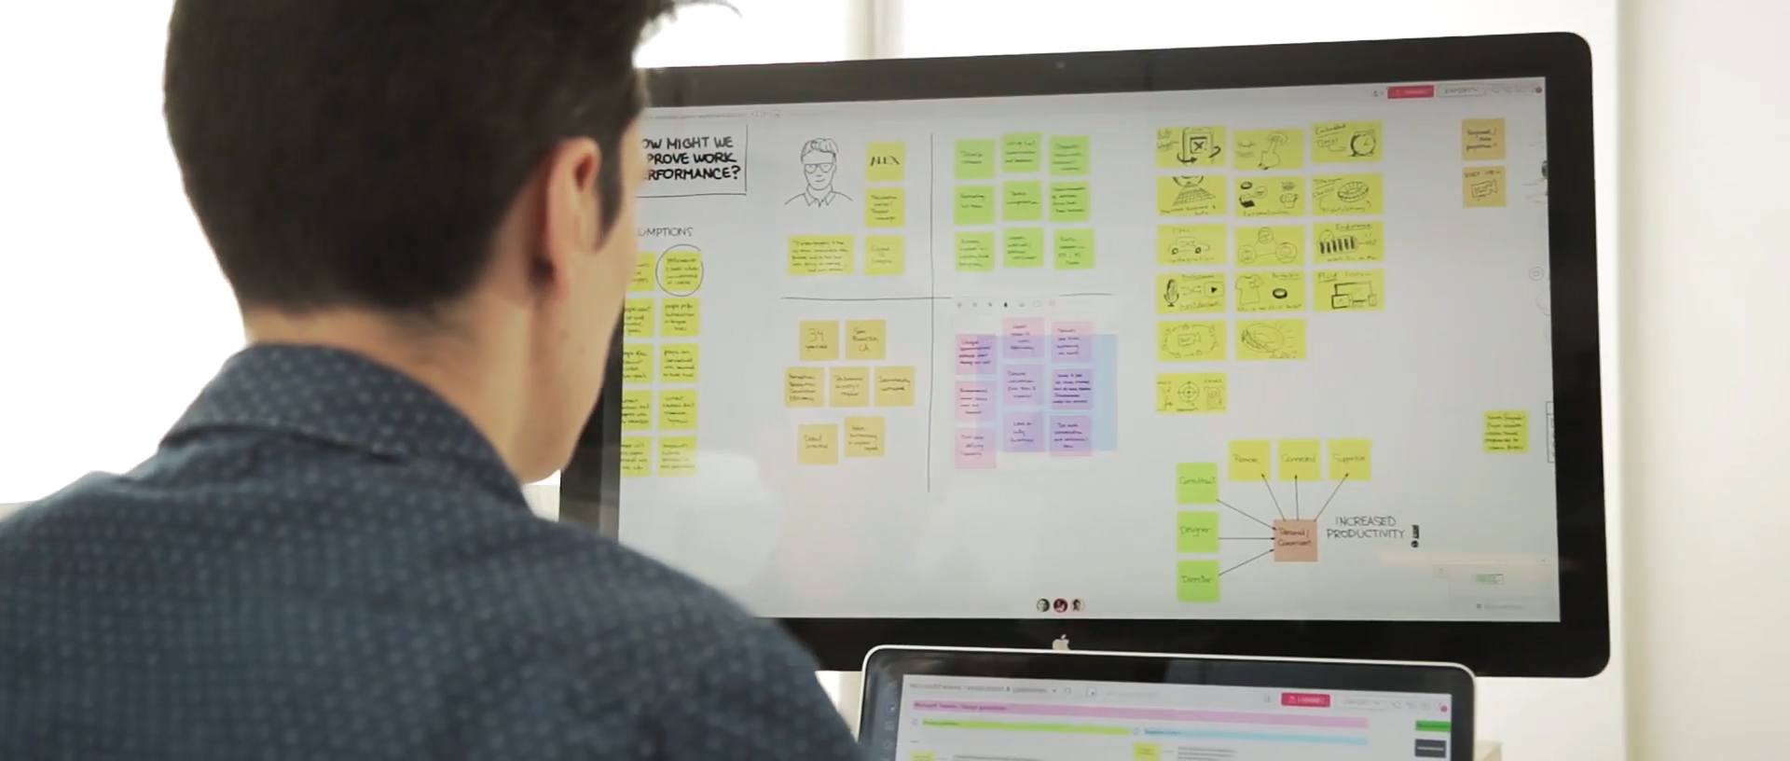
Welcome | Virtual Whiteboard
🚀 Pro Tips
Double click on the background of a mural to create a sticky note
After adding text to a sticky, press tab to create a new one
Zoom with scroll wheel on your mouse or trackpad on your laptop
Pan by holding spacebar and dragging to area of interest
Notes:
solution that addresses one of those problems.

Slide 7
Welcome | Rules
Put phone away, please
Avoid solutions
Avoid crosstalk
Trust the process
Stay on time

Slide 8
Welcome | Coming Up with Clinical Problems
Quantity is Quality
Every problem counts, no matter the scale
Suspend judgement, ignore constraints

Slide 9
Let’s Start!

Slide 10
Warm-up | Cultivate an Elastic Mind
Facilitator provides word prompt
Type the word you associate with the previous word, as quickly as possible
Example: Word Association
Bottle
Water
Waterfall
National Parks
Yellowstone
Bison
Hunting
Mountain Lion
Mountain Dew
Obesity

Slide 11
Reflection | Challenge Statement
What problems prevent you from the best version of care for your patients?
Example Areas
Complex Patient Care
Adverse Events
Poor Ergonomics
Ineffective Treatments
Surgical Complication
Poor Patient Follow-up
Underserved Diseases or Populations
Readmission
Slow Diagnostic Testing
Diagnostic Error

Slide 12
Reflection | Format Clinical Problems
Format
Examples
A way to address…
(problem)
that…
(primary outcome)
A way to characterize heart and lung function that decreases diagnosis time for congestive heart failure
A way to continuously evaluate markers of tissue perfusion in critically ill patients that reduces mortality
Notes:
Each Node is structured as a Clinical Problem Statement
Format

Slide 13
Ideation | The Main Event
If this problem is addressed,
Measurable patient outcomes could be significantly improved
Specific procedure(s) may no longer be necessary
Financial penalties could be avoided
Expensive equipment or inventory may become obsolete
Healthcare delivery would become more inexpensive
Delays could be reduced, increasing appointment volume
Organizational rating(s) would increase

Slide 14
Blocklist | Avoid Rabbit Holes
For now, problems in these areas are out-of-scope…
[ADD CRITERIA HERE]

Slide 15
Individual Voting | Choose your Favorite
Review your individual problems and select top 1-3 you feel is the ‘best’
‘Best’ is open-ended, use your judgement
Embrace the discomfort of throwing problems away
Add a title to each for easy referencing
Be prepared to briefly describe this to the group

Slide 16
Problem Pitch | One Minute per Problem
Tell us about your top problem(s)
Make it succinct and compelling, this may be your only opportunity to persuade other participants
Move them to shared space on virtual whiteboard

Slide 17
Final Vote | Democratic Problem Discovery
Now is the time to ask clarifying questions before the vote
Each participant gets three votes
Distribution is up to you
For example, you may vote three times for same problem; or for three different ones

Slide 18
Done!

Slide 19
Thank you!
…and some final comments

